Slide 1
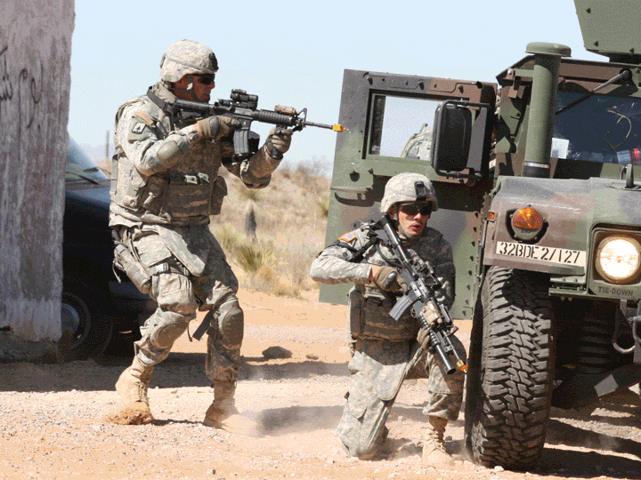
LT2 Standards Calendar
As of 3 Jan 2013

Slide 2
Benefits of Standardization
Commonality
Reduces Developmental Cost
Promote Reuse
Modularity
Reduces lifecycle costs
Improves Reliability, Availability and Maintainability (RAM)
Non-Propriety
Greater vendor depth
Maximize industry involvement in:
Tech Insertion
Developing product-line
Providing Training Capabilities
Interoperability
Live/Virtual/Constructive - -Increases training opportunities and enhances each domain
Joint Service --Train as we fight
Test and Training -- Reduce costs
Extensibility
Enables modernization and embedded training
Accreditation
Improve flexibility in addressing IA/system accreditation
Verification & Validation
Test bed development and utilization
Live Training Standards Stakeholders
INDUSTRY PARTNERS
Government and industry work together to establish Live Training Standards to promote systematic reuse of software and interoperability solutions for the LT2 product line
As of
1/4/2013

Slide 3
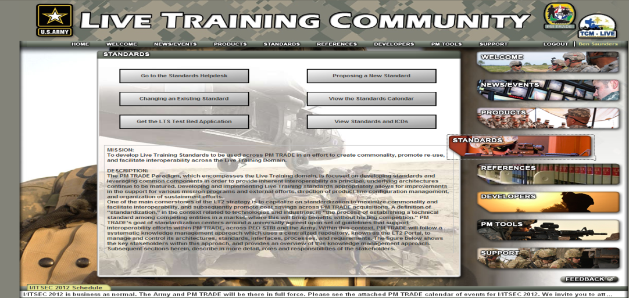
LT2 Processes and Test Bed
LT2 Standards Life-Cycle
Standards and ICD’s on Portal
PM TRADE
Engineering Prep
Draft LT2
Standard
Industry Wide
Working Group
Draft LT2
ICD
Tiger Team
Working Group
Refined LT2
ICD
Live Training Test Bed(s)
Capable of supporting Instrumentation/TESS Interface Standard requirements, PAN Standard requirements, and future live training standards requirements.
Co-located Test Bed in the Government’s Integrated Development Environment (IDE).
Will be used by Government to validate product compliance against Standards and ICDs. Also can be used by industry to test compliance of new products.
Image available on LT2 Portal.
Standing up new MILES test bed capability.
Released
LT2 ICD
Manages/
Updates
ICD
Provides Community
Access
LT2 Standards
IPT
LT2
Portal
1/4/2013

Slide 4
PM TRADE Standards Calendar FY12
FY12
1st QTR
2nd QTR
3rd QTR
4th QTR
Audio Visual Cue Std
Multi Function Vehicle Port
PAN Update (Wired Support)
Equipment Power and Placement
Start of Effort
Published
Industry Feedback
Completed
Active
4
Notes:
A TESS Component Std(s)
AV Cue Standard
Define the audio and visual cues that weapon simulations provide to the training participant. Initial focus is the current TESS devices. (POC: Dasher / APM TRADE)
Common Armor Target Silhouette
Common Power Standard(s)
Develop a set of standard for battery, commercial and portable power sources. (POC: Dasher / APM TRADE)
CTIA/SOA
Equipment Mounting
Live Training Engagement Component (LTEC)
Develop a government owned software module (and associated APIs/ICD) that provide TESS control and computation functionality (POC: ??? / PM LTS)
Mobile Application Framework
Multi Function Vehicle Port
Non Contact Hit Sensor (NCHS) ICD
PAN Standard Update
Scheduled update the PAN standard based on feedback from OneTESS and TCM-Live (POC: ??? PM LTS)
Standard Audio Data Repository
Establish a PM TRADE repository where audio files, as defined in the AV Cue Standard, are located. (POC: Dasher / APM TRADE)
Sound Effects Simulator ICD
Video SOA Extension
Revisit the Video SOA to address proprietary standards dependency, CODEC incompatibility and Pan Tilt Zoom control. (POC: Dasher / APM TRADE)

Slide 5
PM TRADE Standards Calendar FY13
FY13
1st QTR
2nd QTR
3rd QTR
4th QTR
A/V Cue
AV Cue Library
PAN
(AMITS)
PAN Next Gen
Equipment Power and Placement
IS TESS (OneTESS)
Target Standard
PCU-XML
Update
PCU-XML (CTC, CCS, OneTESS
IS TESS Next Gen
Army Aviation and UAS Standard
Start of Effort
Published
Industry Feedback
Completed
Active
Not Started
5
Notes:
A TESS Component Std(s)
AV Cue Standard
Define the audio and visual cues that weapon simulations provide to the training participant. Initial focus is the current TESS devices. (POC: Dasher / APM TRADE)
Common Armor Target Silhouette
Common Power Standard(s)
Develop a set of standard for battery, commercial and portable power sources. (POC: Dasher / APM TRADE)
CTIA/SOA
Equipment Mounting
Live Training Engagement Component (LTEC)
Develop a government owned software module (and associated APIs/ICD) that provide TESS control and computation functionality (POC: ??? / PM LTS)
Mobile Application Framework
Multi Function Vehicle Port
Non Contact Hit Sensor (NCHS) ICD
PAN Standard Update
Scheduled update the PAN standard based on feedback from OneTESS and TCM-Live (POC: ??? PM LTS)
Standard Audio Data Repository
Establish a PM TRADE repository where audio files, as defined in the AV Cue Standard, are located. (POC: Dasher / APM TRADE)
Sound Effects Simulator ICD
Video SOA Extension
Revisit the Video SOA to address proprietary standards dependency, CODEC incompatibility and Pan Tilt Zoom control. (POC: Dasher / APM TRADE)

Slide 6
PM TRADE Standards Calendar FY14
FY14
1st QTR
2nd QTR
3rd QTR
4th QTR
Update PAN
IS TESS Next Gen
PCU-XML
Remote Configuration Management
Target Std
Start of Effort
Published
Industry Feedback
Completed
Active
Not Started
6
Notes:
A TESS Component Std(s)
AV Cue Standard
Define the audio and visual cues that weapon simulations provide to the training participant. Initial focus is the current TESS devices. (POC: Dasher / APM TRADE)
Common Armor Target Silhouette
Common Power Standard(s)
Develop a set of standard for battery, commercial and portable power sources. (POC: Dasher / APM TRADE)
CTIA/SOA
Equipment Mounting
Live Training Engagement Component (LTEC)
Develop a government owned software module (and associated APIs/ICD) that provide TESS control and computation functionality (POC: ??? / PM LTS)
Mobile Application Framework
Multi Function Vehicle Port
Non Contact Hit Sensor (NCHS) ICD
PAN Standard Update
Scheduled update the PAN standard based on feedback from OneTESS and TCM-Live (POC: ??? PM LTS)
Standard Audio Data Repository
Establish a PM TRADE repository where audio files, as defined in the AV Cue Standard, are located. (POC: Dasher / APM TRADE)
Sound Effects Simulator ICD
Video SOA Extension
Revisit the Video SOA to address proprietary standards dependency, CODEC incompatibility and Pan Tilt Zoom control. (POC: Dasher / APM TRADE)

Slide 7
PM TRADE Standards Calendar
The current PM TRADE Standards Calendar, as well as all current PM TRADE standards, process for changing a standard and establishing a new standard, may be found on the LT2 Portal: https://www.lt2portal.org/ , then select the Standards Link.
The schedule is tentative and may change.

