Slide 2
Scott Pulford
Acting Project Manager Training Devices (PM TRADE)

Slide 3
Business Opportunities Summary
Organization | Program | RFP Release | Award Date
PD DT | LCPM | 4th Qtr FY16 | 1st Qtr FY18
PdM LTS | I-MILES | 4th Qtr FY17 | 2nd Qtr FY18
PdM LTS | OSWV | 2nd Qtr FY18 | 2nd Qtr FY19
PdM GCTT | Abrams ED/TT | 1st Qtr FY17 | 4th Qtr FY17
PdM GCTT | CDT | TBD | TBD
PdM GCTT | JLTV | 3rd Qtr FY17 | TBD
PdM GCTT | Stryker MTS | 1st Qtr FY17 | 4th Qtr FY17
PdM CTIS | JRTC-IS LE | TBD | TBD
PdM CTIS | MPC | 3rd Qtr FY16 | 1st Qtr FY17
PdM GCTT | C-130J RWST
Note: All Dates are Tentative
Acronym Key
LCPM - Life Cycle Product-line Management
CDT- Common Driver Trainer
I-MILES - Instrumentable - Multiple Integrated Laser
Engagement System
JLTV – Joint Light Tactical Vehicle
Stryker MTS – Stryker Maintenance Trainer System (MTS)
Phase V
OSWV – Opposing Force Surrogate Wheeled Vehicle
JRTC-IS LE – Joint Readiness Training Center
Instrumentation System – Land Expansion
Abrams ED/TT – Abrams Engine Diagnostic and Troubleshooting Trainer
C-130J RWST – C-130J Reconfigurable Weapon System Trainers
MPC – Mobile Production Center

Slide 4
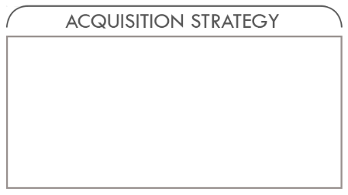
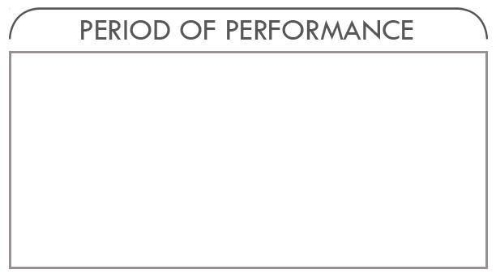
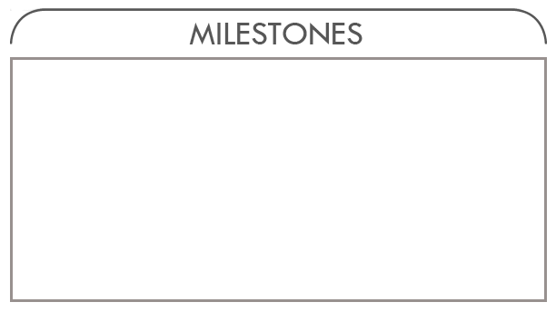

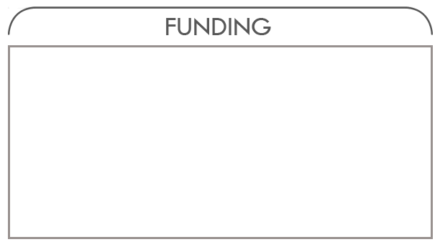
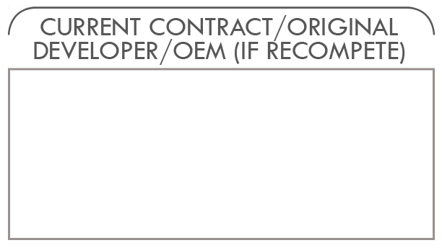
Life Cycle Product-line Management (LCPM)
Description/Summary of Program Requirements
Provides life cycle management and hardware product line development in support of live training systems:
The Digital Range Training System (DRTS) program comprised of the following range types: Digital Multi-Purpose Range Complex (DMPRC), Digital Multi-Purpose Training Ranges (DMPTR), Battle Area Complex (BAX), Digital Air/Ground Integration Range (DAGIR)
Integrated Military Operation in Urban Terrain (MOUT) Training System (IMTS) comprised of the following range types: Urban Assault Course (UAC), Shoot house, Combined Arms Collective Training Facility (CACTF)
Targetry Range Automated Control and Recording (TRACR); and Location of Miss And Hits (LOMAH)
Homestation Instrumentation comprised of the following range types: Joint Pacific Multinational Readiness Capability – Instrumentation System (JPMRC-IS), Homestation Instrumentation Systems (HITS)
Combat Training Centers: National Training Center (NTC), Joint Readiness Training Center(JRTC) & Joint Multinational Readiness Center (JMRC)
Acquisition Strategy: Full & Open
Contract Vehicle: Single Award IDIQ
Contract Type: FFP, Cost, and T&M
5 years
Sep 14
RFI Release
Oct 15
PALT
Initiation
4th Qtr FY16
RFP Release
1st Qtr
FY18
Contract
Award
Organization: PM TRADE
Phone: 407-384-5201
Email: usarmy.orlando.peo-stri.list.pm-training-devices@mail.mil
OPA/OMA/RDT&E: Estimated $465 M is ceiling
N/A

Slide 5
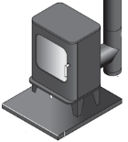

Life Cycle Product-line Management (LCPM)
Currently
LCPM will provide two main objectives for PM TRADE:
A single contract vehicle for programs to perform hardware centric lifecycle tasks.
  Technology refreshment
  Obsolescence management
  Concurrency
  Technology insertion
  Upgrades
  Disposal for LT2 systems
  Support LT2 programs
  Other DoD customers
Apply a product-line methodology, similar to the way Consolidated Product-line Management (CPM) Next does this for software centric tasks, to establish a Hardware Product Line (HPL).
Program
requirements
Program
requirements
Program
requirements
Product
Product
Product
LCPM
Program
requirements
Program
requirements
Program
requirements
Program
requirements
Product
Product
Product
Product

Slide 6
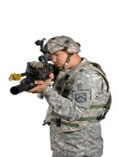
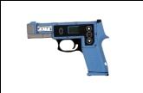
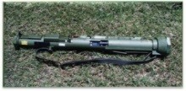
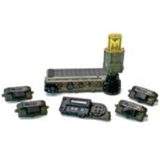
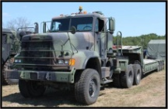
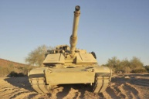
MILES Relevancy Contract
Evolving Weapons Platforms (JLTV, AMPV, ESR, M4A1+, etc.. Weapons PMs)
ATESS Inc 3 (Direct Fire) FY34-48
New Technology (PEOs)
ATESS Inc 1 (Architecture/Indirect Fire) FY26-39
ATESS Inc 2 (Area Denial/CBRNE/ADA) FY30-42
2015
2020
2021
2026
2027
2029
2031
2035
2038
2048
I-MILES BOI
Complete Quantity Fielded ~ 204,639 Kits
EUL for TVS
EUL for IWS2
EUL for WITS
EUL for IWS1, UCD, SLM
EUL for CVS
EUL for VTESS
STRATEGIC ISSUES
ATESS Increment 1
MS B in FY26-39
ATESS Increment 2
MSB in FY30
ATESS Increment 3
MSB in FY34
Direct Fire fielding starts
in FY38 and completes in
FY48
Platforms and technology continue to evolve
All fielded I-MILES systems will reach EUL before ATESS
I-MILES Quantity Fielded by FY20 - 204,639 Vehicle, Dismounts, Ancillary Kits
SLM - AT4, RPG
IWS
UCD
BDM
WITS
TVS
CVS
Instrumentable Versions
VTESS
*WITS: Wireless Independent Targeting Sys (9,479 Kits Fielded – EUL 2021)
IWS1: Individual Weapons System (59,942 Kits Fielded – EUL 2026)
SLM: Shoulder Launched Munitions (5,912 Kits Fielded – EUL 2026)
TVS: Tactical Vehicle System (16,515 Kits Fielded) – EUL 2026
CVS: Combat Vehicle System (2,928 Kits Fielded) – EUL 2029
IWS2: Individual Weapons System (101,047 Kits Fielded) – EUL 2031
VTESS: Vehicle Tactical Engagement Simulation System (9,004 To be Fielded) – EUL 2033

Slide 7
MILES Relevancy Contract
Description/Summary of Program Requirements
I-MILES is a critical component to “live” force-on-force training capability that impacts the overall training effectiveness for units to operate in a training environment. Ensuring the systems remain available, operational and concurrent with evolving technology for the next 30 years is essential.
The I-MILES Relevancy Contract is an effort to address I-MILES relevancy as the (1) systems approach end of useful life (beyond economically repairable), (2) weapon systems and technologies continue to evolve, and (3) Army - Tactical Engagement Simulation System (A-TESS) capabilities document approval is delayed.
The contract will address technology insertions, obsolescence issues, componentization efforts and the implementation of the Government owned software (LTEC) until A-TESS increment 3 around the FY38 timeframe.
Acquisition Strategy: TBD
Contract Vehicle: Multi Award – IDIQ
Contract Type: TBD
FY18-FY22
1st Qtr FY17
2nd Qtr FY17
4th Qtr FY17
2nd Qtr FY18
1 year base & 4 option years
RFI Release
Industry
Day
RFP Release
Contract
Award
Organization: PM TRADE
Estimated $49M OPA
Estimated $40M RDTE
Phone: (407) 384-5201
Current I-MILES OEMs
Email: usarmy.orlando.peo-stri.list.pm-training-devices@mail.mil

Slide 8
Opposing Force Surrogate Wheeled Vehicle (OSWV)
Description/Summary of Program Requirements
This program supports the Combat Training Centers Opposing Forces/Center of Excellence (CTC OPFOR/COE) Pillar capability by providing OPFOR Surrogate Wheeled Vehicles (OSWV), technical vehicles, unique Visual Modifications (VISMODs), and Civilian on the Battlefield Vehicles (COB-Vs). This capability provides for an accurate replication of OPFOR and COB vehicle environment that rotational units must train against.
Acquisition Strategy: Full & Open
Contract Vehicle: TBD
Contract Type: TBD
FY19-FY23
4th Qtr FY16
2nd Qtr FY17
2nd Qtr FY18
2nd Qtr FY19
1 year base & 4 option years
RFI Release
SSN Release
RFP Release
Contract
Award
Organization: PM TRADE
Phone: (407) 380-5201
Email: usarmy.orlando.peo-stri.list.pm-training-devices@mail.mil
Estimated $39M - $65M
New procurement

Slide 9
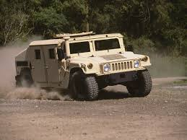
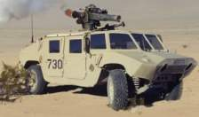
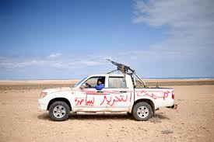
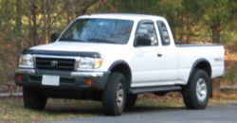
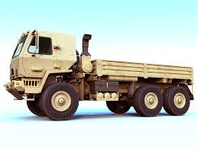
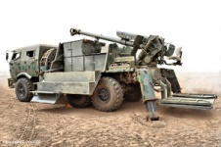
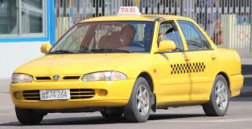
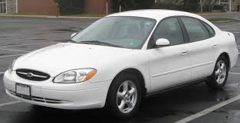
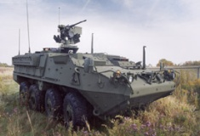
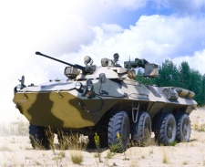
OPFOR Surrogate Wheeled Vehicles (OSWV)
OSWV Overview
OSWV will be composed of three components:
  Tactical vehicles – use existing vehicles in the Army inventory
  A visual modification – attaches hardware to US tactical vehicles to visually represent enemy
  Tactical Engagement Simulation Systems (TESS). The TESS, fielded by PM TRADE, provides the ability to shoot and be shot, with lasers, in a training environment
Used as a training aid to portray threat vehicle
  Tactical – e.g., Stryker (portrayal of Russian armored personnel transporter)
  Technical – e.g., Toyota truck with .50 caliber mounted
  Civilian on the Battlefield vehicles (COB-V) – e.g., civilian driven vehicle (sedan painted like taxi)
Five Variants
HMMWV
RSTA / ATGM
Technical
Commercial Pick-up
FMTV
Indirect Fire
COB-V
Commercial Vehicle
Stryker
APC
Tactical
Commercial

Slide 10
Abrams Engine Diagnostic and Troubleshooting Trainer (ED/TT)
Description/Summary of Program Requirements
Anticipate a new acquisition for an upgrade of the existing Abrams M1A1 Engine Trainers at Ft. Benning, GA., Ft. Lee, VA., and Gowen Field, ID., to the M1A2 SEPv2 configuration. The Engine Diagnostic and Troubleshooting Trainers (ED/TTs) are required to support the Program of Instruction (POI) for the 91A, 913A and 915A Military Occupational Specialties (MOSs). The ED/TT will provide training in diagnostic and troubleshooting tasks of the Abrams M1A2 SEPv2 Engine and associated electronics, cables and Line Replaceable Units (LRUs). The objective is for eleven (11) SEPv2 ED/TTs. Quantity of 2 FY17, 5 FY18 and 4 FY19.
Acquisition Strategy: Full & Open
Contract Vehicle: Stand Alone C
Contract Type: FFP
3 Years
3rd Qtr FY16
SSN Release
1st Qtr FY17
RFP Release
4th Qtr FY17
Contract Award
Organization: PM TRADE
Phone: (407) 380-5201
Email: usarmy.orlando.peo-stri.list.pm-training-devices@mail.mil
Estimated Range: $7M - $17.5M
New contract

Slide 11
Common Driver Trainer (CDT)
Description/Summary of Program Requirements
This new work will include continuation for all 5 current variants and 1 new variant of the CDT Variants. The goal is to develop a single software/hardware baseline that can meet the requirements of each variant, based on the Cab/Dash installed. Early estimates of requirements for this contract vehicle by variant are:
1. Stryker Variant (SV): 4 new Dual V Hull cabs along with 14 (1 IOS : 1 STS) System Tech Refresh (multiple sites)
2. Tank Variant (TV): 18 CDT TV (1:1) System Tech Refresh and Abrams Common Software Library and improved Drivers Integrated Display updates (Ft. Benning, GA)
Tank Engineering Variant (TEV): Update of Joint Assault Bridge interface hardware, software along with 3 (1:2) CDT TEV systems Tech Refresh (Ft Leonard Wood, MO)
MRAP Variant (MV): 14 (1:1) CDT MV System Tech Refreshes (multiple sites)
Tactical Wheel Variant (TWV): Build to Print 18 (1:4) New CDT TWV Systems (Ft Leonard Wood, MO)
Joint Light Tactical Variant (JLTV): 8 Cabs and 35 dashboards (Location - TBD)
* Sustainment of the CDT Systems will be accomplished through War Fighter Focus sustainment contracts.
Acquisition Strategy: Full & Open
Contract Vehicle: Stand Alone C
Contract Type: ID/IQ
5 years
TBD
SSN
Release
TBD
RFP
Release
TBD
Contract Award
Organization: PM TRADE
Phone: (407) 380-5201
Email: usarmy.orlando.peo-stri.list.pm-training-devices@mail.mil
Estimated at: $52.7M
Current Contract: None, EFO CPFF/FFP in process
Original Developer: SAIC

Slide 12
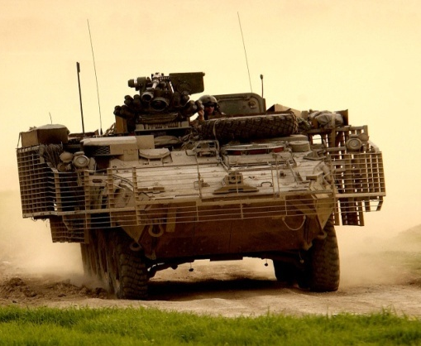
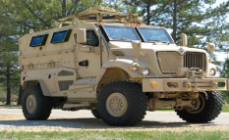
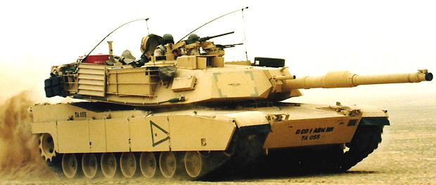
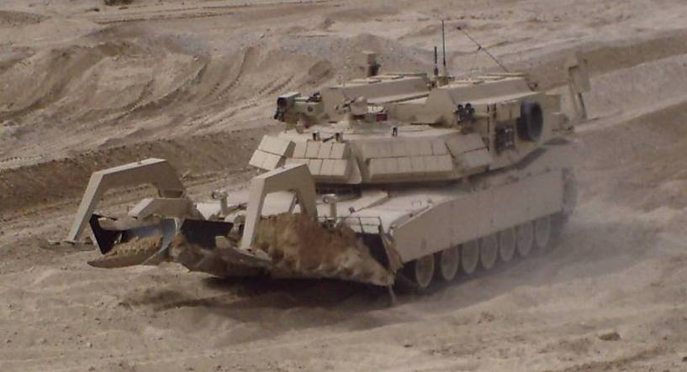
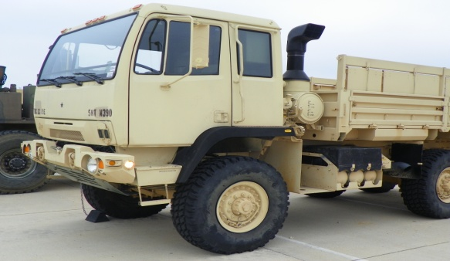
Common Driver Trainer (CDT) Product Line
STRYKER VARIANT
(SV)
REQUIREMENTS
MRAP VARIANT
(MV)
REQUIREMENTS
TANK VARIANT
(TV)
REQUIREMENTS
TANK ENGINEER VARIANT (TEV)
REQUIREMENTS
TACTICAL WHEEL VARIANT (TWV)
REQUIREMENTS
20% Variant Specific Parts
Vehicle Cab & Dashboard
Vehicle Dynamics
Specialized Scoring
1 Instructor to 1 Student configuration
Vehicle Cab & Dashboard
Vehicle Dynamics
Specialized Scoring
1 Instructor to 1 Student configuration
Vehicle Cab & Dashboard
Vehicle Dynamics
Specialized Scoring
1 Instructor to 1 Student configuration
Vehicle Cab & Dashboard
Vehicle Dynamics
Specialized Scoring
Tank Commander Station
1 Instructor to 2 Student configuration
Vehicle Cab & Dashboard
Vehicle Dynamics
Specialized Scoring
Assistant Driver station
1 instructor to 4 Students configuration
80% CDT Common Elements Across All CDT Variants
6 Degrees of Motion
Instructor/Operator Station
After Action Review Station
Databases
Displays
Image Generators
Projectors
Computers
Common Scoring Features
Reconfigurable
Scenario Generation
Common Data Server
Class Manager
Common components/reuse
Common Training
Instructor and Maintenance procedures
User and Operator Manuals
Testing/troubleshooting
Diagrams/drawings
Reduced Spares

Slide 13
Joint Light Tactical Vehicle (JLTV) Maintenance Training System (MTS)
Description/Summary of Program Requirements
Anticipate a new acquisition for JLTV. The JLTV MTS will consist of Diagnostic Troubleshooting Trainers (DTTs) and Hands On Trainers (HOTs) that will support the Program of Instruction (POI) for the 91B Military Occupational Specialty (MOS). These training devices are expected to provide training in diagnostic, troubleshooting, remove and replace tasks of the JLTV vehicle. Key areas for training include the vehicle electrical system, drive train, suspension, along with a distributed training capability. Quantities are estimated at 59 each pending additional analysis.
Acquisition Strategy: Full & Open
Contract Vehicle: Stand Alone C
Contract Type: CPI/FPI
5 Years
1st Qtr FY17
RFI
Release
3rd Qtr FY17
RFP
Release
TBD
Contract
Award
Organization: PM TRADE
Phone: (407) 380-5201
Email: usarmy.orlando.peo-stri.list.pm-training-devices@mail.mil
Estimated $98.8M
New contract

Slide 14
Stryker Maintenance Trainer System (MTS) Phase V
Description/Summary of Program Requirements
The Stryker MTS is designed to teach troubleshooting and remove/replace tasks to the 91S, Stryker System Mechanic Military Occupational Skill (MOS).
Enhance the capabilities of the current system by converting remaining Diagnostic Troubleshooting Trainer (DTT) lessons to 3D graphics and development of hands on trainers for the Stryker Remote Weapon Station (RWS), Mortar Carrier (MC), Anti-Tank Guided Missile ATGM), Mobile Gun System (MGS) vehicles and a C7 Engine trainer. This must be accomplished through the reuse of the existing system architecture, software design, functionality, User and Instructor/Operator (I/O) interfaces and capabilities to select lessons from the Training Task List (TTL).
Acquisition Strategy: Full & Open
Contract Vehicle: Stand Alone C
Contract Type: CPI/FFP
5 Years
4th Qtr FY16
SSN
Release
1st Qtr FY17
RFP
Release
4th Qtr FY17
Contract
Award
Organization: PM TRADE
Phone: (407) 380-5201
Email: usarmy.orlando.peo-stri.list.pm-training-devices@mail.mil
Estimated $61M
Current Contract Phase IV: DiSTI
Original Equipment Manufacturer: Rockwell Collins

Slide 15
Joint Readiness Training Center Instrumentation System - Land Expansion (JRTC-IS LE)
Description/Summary of Program Requirements
Provide instrumentation system (IS) coverage in the JRTC Land Expansion area to support the JRTC Operations Group in the generation and execution of After Action Reviews (AARs).
All solutions must seamlessly integrate with the existing systems of the IS.
All construction in the Land Expansion area must comply with the appropriate National Environmental Protection Act (NEPA) provisions.
Acquisition Strategy: Full & Open
Contract Vehicle: Stand Alone C
Contract Type: TBD
1 year base & 2 option years
June 16
RFI
Release
TBD
RFP
Release
TBD
Contract
Award
Organization: PM TRADE
Phone: (407) 380-5201
Email: usarmy.orlando.peo-stri.list.pm-training-devices@mail.mil
Estimated $25M
New Procurement

Slide 16
Joint Readiness Training Center Instrumentation System - Land Expansion (JRTC-IS LE)
The capabilities that will be extended into the Land Expansion area are:
The Range Communication System (RCS) infrastructure consisting of cell tower sites and a Fiber Optic Network (FON) connecting to the Data Center (DC) at the Joint Operations Center (JOC). The DC will be able to integrate and facilitate the data from FON expansion.
The JRTC Aviation Network Infrastructure (ANI) network at the JRTC to support the aviation training.
The Voice Tactical Monitoring (VTM) system at the JRTC to support recording of voice traffic from SINCGAR radios.
The Microwave (MW) data transfer system for the movement of After Action Reviews (AAR) and other data to/from the Mobile Production Centers (MPC).

Slide 17
Mobile Production Center (MPC)
Description/Summary of Program Requirements
Tech Refresh of the Joint Readiness Training Center (JRTC) Mobile Production Center (MPC), which is comprised of a Mobile After Action Review (MAAR) Theater, Mobile Production Unit (MPU) and a trailer-mounted electrical power generator and microwave set (Power and Antenna Trailer (PAT)).
Acquisition Strategy: Full & Open
Contract Vehicle: STOC II
Contract Type: FFP
18 Months
Jul 15
SSN
Release
Nov 15
Industry
Day
3rd Qtr FY16
RFP Release
1st Qtr FY17
Contract
Award
Organization: PM TRADE
Phone: (407) 380-5201
Email: usarmy.orlando.peo-stri.list.pm-training-devices@mail.mil
Estimated $4.5M
New Procurement

Slide 18
Near Term Programmatic Impact Areas
Logistics (Property Accountability) – Continued emphasis on component and end item inventory listings to support transfer to gaining installations/commands.
Cyber Security (RMF) – Growing emphasis on safeguarding our systems and networks.
Lighthouse Effort (Data Driven) – Standardizing and digitizing our Tech Data Package and Logistics Product Data to Catalogue/reuse that data to eliminate redundancy and automate document production.
Multinational Interoperability – The composition of the Brigade Combat Team formation has evolved to include coalition partner formations; we are looking for opportunities to mitigate training challenges with those conditions.
Public Private Partnerships (PPP) – Actively exploring opportunities to leverage the Army’s organic industrial base to support TADSS development, production and/or sustainment.

Slide 19
PM TRADE Business Goals
Reduce operational costs and complexity
Align and support product development (common standards, interfaces, etc.)
Enhance soldier training
Reduce sustainment and development costs
Increase technology agility
Leverage other Army systems and Commercial Off the Shelf (COTS) technologies
Align to the Army COE, mobile computing, and distributed computing strategies

Slide 20
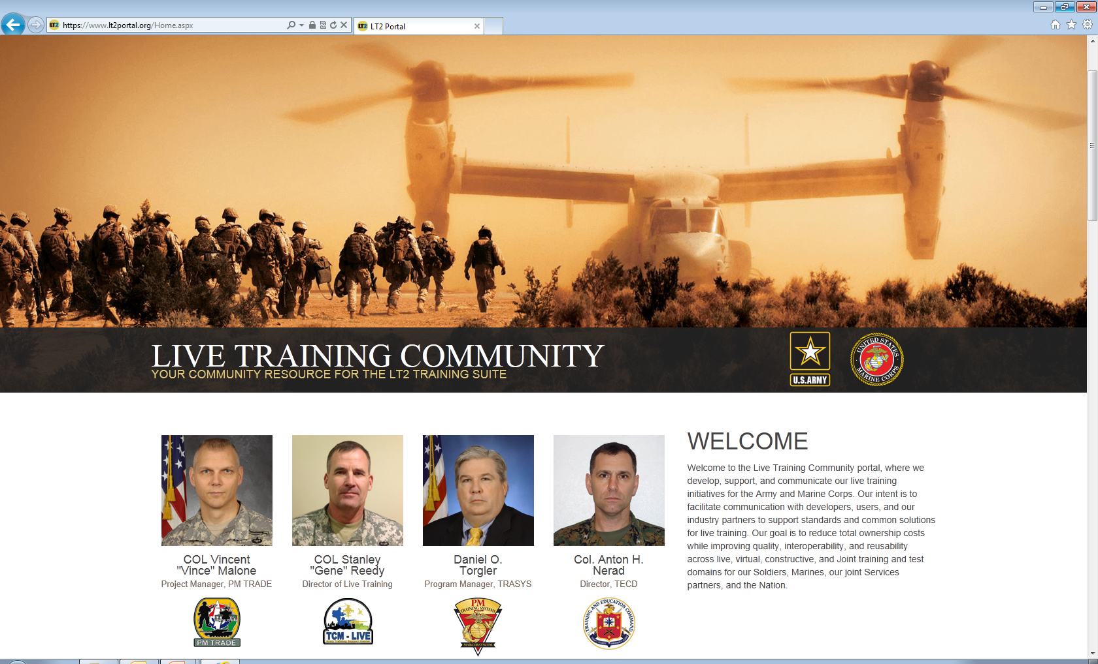
LT2 Portal
LT2Portal.mil is the official site for the Live Training Community
Join the Live Training Community @ WWW.LT2Portal.mil to find out how we’re saving DoD programs millions of dollars.

